Slide 1
Q4 ASHE Chapter
Leader and Liaison Call
December 4, 2024

Slide 2
Welcome!

Slide 3
Agenda
Welcome to Christina Fissori
Upcoming Chapter Due Dates and Program Updates
Chapter Winner Announcement for the Core Competency Framework Campaign Contest
ASHE/NTCC Healthcare Facility Technician Program
ICC Code Action Hearing 2
ASHRAE/ASHE Guideline 43
Academic Medical Center Sustainability Community
2025 Sustainability Task Forces
ASHE/EPA ENERGY STAR Verification Program

Slide 4
Chapter Leader/Liaison Slide Deck
This slide deck will be shared on the “Chapter Communications and Meeting Recordings” page on ASHE.org.
The slide deck is intended to be used by the liaisons and chapter leaders to assist in sharing information with chapters. The slide deck is not to be shared with others.
By downloading the presentation slides, you agree to use it for sharing information purposes only.

Slide 5
Welcome, Christina Fissori!

Slide 6
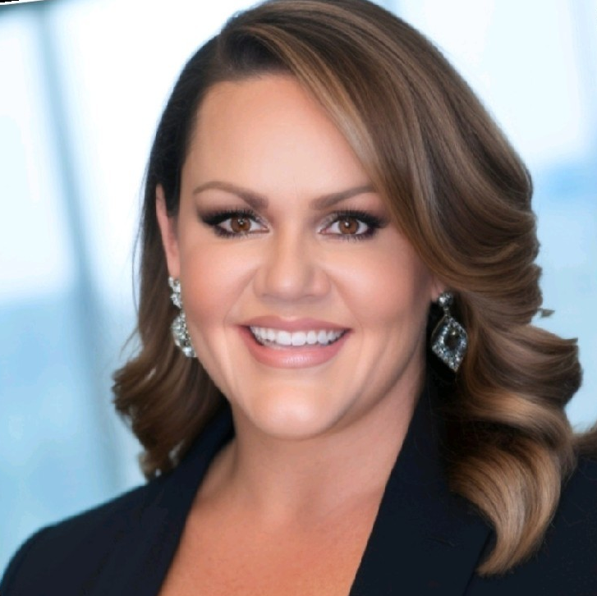
Welcome!
Christina Fissori
Director, Member Engagement
cfissori@aha.org

Slide 7
Upcoming Chapter Due Dates and Program Updates

Slide 8
Important Chapter Due Dates
Chapter Annual Report and Awards Application – Due April 1, 2025
2026 Chapter Challenge – Due April 1, 2025
Emerging Regional Leader Award – Due April 1, 2025
Chapter Vouchers (for the 2024 Chapter Awards)
  Health Care Facilities Innovation Conference Vouchers – Due June 30, 2025
  ASHE Membership, CHFM/CHC Exam, and Publication Vouchers – Due October 31, 2025.

Slide 9
Chapter Annual Report and Awards Application Timeline
January 2, 2025 – Portal Launched
April 1, 2025 – Application/Report Due; Portal Closes
June 2025 – Chapters notified of award results
July 27-30, 2025 – Chapters receive awards and are recognized at the Chapter Leadership Forum (CLF) and the Health Care Facilities Innovation Conference

Slide 10
Changes to the Chapter Annual Report and Awards Application
No changes to the 2025 Award Criteria (there will be minor changes for the 2026 Chapter Awards).
Annual Report and Awards Application are now combined!
New software! Allows Chapters to have multiple individuals completing the form and able to save form and finish later.
  Chapters will need to create a login to complete the form.
  ASHE staff is able to access form on the backend if users run into issues.
  Almost ALL of ASHE’s award applications will be housed in this new software!
Additional questions added to help inform ASHE staff of what resources Chapters need. These questions will NOT affect chapter or award status.
  A quick demo…

Slide 11
Winner Announcement for the Core Competency Framework Campaign Contest

Slide 12

Contest Overview
Share information about ASHE’s Core Competency Framework between September 1 and November 1.
2x in a newsletter or dedicated email to chapter members
2x on LinkedIn, X or Facebook

Slide 13
Regions with Most Participation
67% Participation
Region 5
80% Participation
Region 8

Slide 14

Congratulations!

Slide 15
ASHE/NTCC Healthcare Facility Technician Program

Slide 16

Healthcare Facility Technician Training Course
Available late 2025/early 2026
4 Month Classroom Program + 6 Month externship
Includes:
Health Care Physical Environment Worker
Fast track to the MECH Certification
Other Certifications
Needed to run the program:
Host Chapter
Instructor to teach provided course content
Partner Community College
Hospitals ready to accept externships and hands-on application

Slide 17
Healthcare Facility Technician Training Course
Available late 2025/early 2026
Course includes the following certifications:
ASHE’s Certified Health Care Physical Environment Worker
ASHE’s Mechanic Evaluation and Certification for Healthcare (MECH)
Certified Healthcare Emergency Power Professional (CHEPP)
NC3 Fundamentals of Electricity AC / DC Certification
ASSE 6040 Medical Gas Maintenance Personnel
EPA Section 608 Certification / A2L Low GWP refrigerant

Slide 18
ICC Update

Slide 19
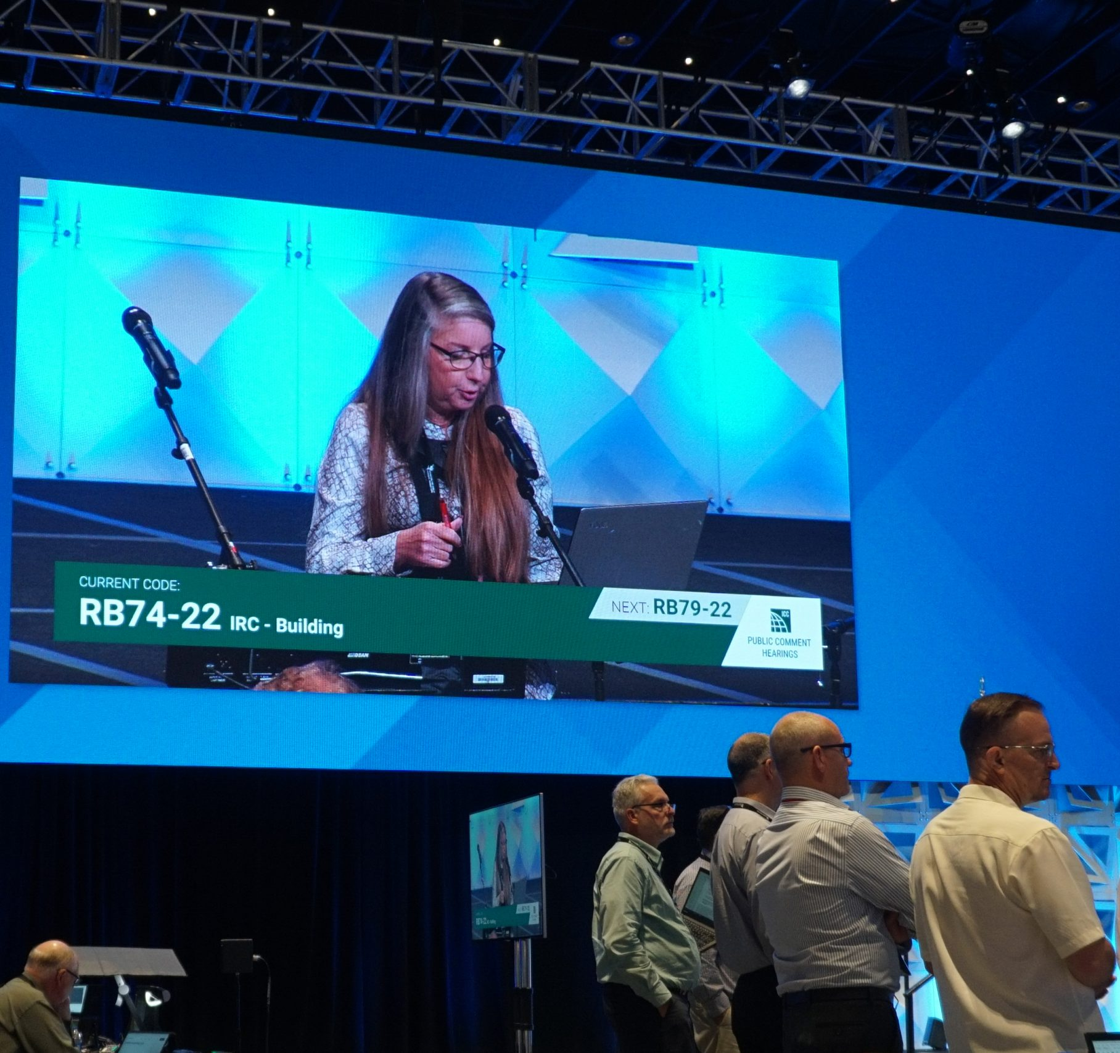
ICC Second Code Action Hearings Results
Held October 23rd – Oct 30th
Committee on Health Care testified regarding several proposals
Definition of Clinical Need Approved
An enhanced level of safety or security required to address care or welfare risks for care recipients

Slide 20
ICC Second Code Action Hearings Results
Requirement for closers on Group I-1
Automatic closers on corridor doors within Assisted Living Facilities will not be required
Handwashing Station water temperature
Final solution has not been achieved to this issue
Progress made with opponents to assist in drafting acceptable language for public comment hearings
Public Comment Hearings
Deadline for submitting comments - March 14, 2025
Public Comment Hearings to be held - April 19 - 28, 2026

Slide 21
ASHRAE Update

Slide 22
ASHRAE/ASHE Standard 170
Addendum m 1st Public Review opening 13 Dec – 27 Jan
Provides new definition for room unit
Revises Tables 7-1, 8-1, 8-2 and 9-1 to incorporate types of room units that are allowable for each space type
Revises the requirements for air change rate provisions with respect to room units
Watch for announcement in HFM Insider
Addendum r 2nd public review closed with no comments
Revises Table 9-1 Design Parameters for Residential Health, Care, and Support-Specific Spaces
Addendum s 1st public review closed with 1 comment
Provides alignment with FGI spaces

Slide 23
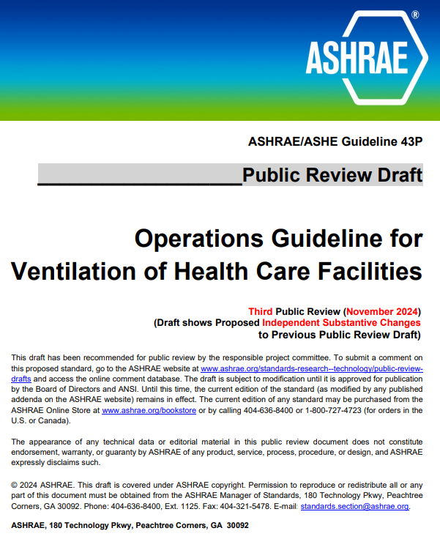
ASHRAE/ASHE Guideline 43
  3rd Public Review issued
  Independent Substantive Change
  Open for comment November 22, 2024 to
  January 6, 2025
  Announced within ASHE Insider 26 November
  Have received 2 comments to date
  Work group to address comments as they are
  received

Slide 24
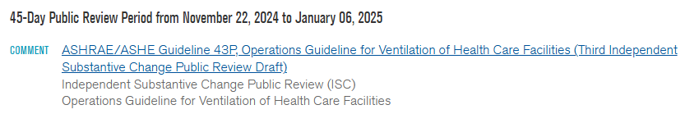
Call to Action
Open for comments until 6 January 2025
Please share with chapter members
To comment visit ASHRAE Public Review Draft Standards Webpage
  https://osr.ashrae.org/default.aspx

Slide 25
Sustainability and Decarbonization

Slide 26
AMC Sustainability Interest Group
Collaborative community supported by ASHE, the Association of American Medical Colleges (AAMC), and Practice Greenhealth​
  Bimonthly meetings to connect on critical topics of sustainability and climate action specific to academic medicine. ​
  Online platform to connect, share, and learn virtually.​
  Over 435 current members.​
  In-person opportunities at national meetings such as CleanMed, ASHE Conferences, and AAMC Annual Meeting.

Slide 27
AMC Sustainability Interest Group​
Last event was held Thursday, October 31st.
  Welcomed four speakers who presented on the role of Medical Directors of Sustainability in their organizations.
    Recording is available in the online community
If you, or members of your chapter, are affiliated with an Academic Medical Center and wish to get involved, reach out to awallace@aha.org for more details.
January 9th - 3pm ET
    On The Front Lines of Health Care and Climate Change: What Can We Learn from Crisis Response?

Slide 28
2025 Sustainability Task Forces
Call for Volunteers will be posted on myASHE in December
Aiming to kick off in early 2025
Two Task Force focus areas
    Sustainability in Reliability Centered Maintenance
    Sustainability Innovation
A third Task Force is still in the works
Please share this message and the Call for Volunteers with your chapter membership.

Slide 29

ASHE/EPA Pro Bono Verification Program
Collaboration with EPA’s ENERGY STAR program.
Connect ASHE Licensed Professional (PE or RA) member volunteers with health care facilities looking to get ENERGY STAR certified.
QR code takes you to the webpage for volunteer sign ups.
If your hospital is eligible but needs LP verification, or you are a PE/RA that wants to volunteer to verify, please complete the form and we will be in touch.
We need your help launching this program. Please share with your chapter membership.

Slide 30
2025 Meeting Dates and Upcoming Events

Slide 31
2025 Chapter Calls
Q1: Wednesday, March 5, 2025
Q2: Wednesday, June 4, 2025
Q3: Wednesday, September 3, 2025
Q4: Wednesday, December 3, 2025
All calls begin at 12:05 noon CT.
Call reminders – Chapter Calendar and the Liaison
  SharePoint site
2025
Call Dates
ashe.org/chapters/calendar

Slide 32


Save the Date!
July 27-30, 2025 | Columbus, OH

Slide 33

Questions or Discussion?

Slide 34
Thank you!

