Slide 1
Q1 ASHE Chapter Leader and Liaison Call
March 6, 2024

Slide 2
Welcome!

Slide 3
Agenda
NFPA Update
Chapter Web Updates
ASHE, PGH, AAMC Academic Medical Center Sustainability Community
ASHRAE Update
170, GP43 and 514/188
Sustainability Update
Chapter Challenge, Dashboard Updates
Important Chapter Due dates
ICC Update – 2027 Update
Regional Nominating Committees
PDC Sustainability Sessions
2024 Meeting Dates and Upcoming Events

Slide 4
Chapter Leader/Liaison Slide Deck
This slide deck will be shared on the “Chapter Communications and Meeting Recordings” page on ASHE.org.
The slide deck is intended to be used by the liaisons and chapter leaders to assist in sharing information with chapters. The slide deck is not to be shared with others.
By downloading the presentation slides, you agree to use it for sharing information purposes only.

Slide 5
NFPA Update/Advocacy

Slide 6
Current Standards Open for Public Input
Open Until 4 April 2024
NFPA 1, Fire Code
Open Until 7 January 2025
NFPA 85, Boiler and Combustion Systems Hazards Code

Slide 7
Current Standards Open for Public Input
Open Until 4 June 2024
NFPA 99, Health Care Facilities Code
NFPA 101, Life Safety Code
NFPA 3, Std for Commissioning of Fire Protection and Life Safety Systems
NFPA 4, Std for Integrated Fire Protection and Life Safety System Testing
NFPA 17, Standard for Dry Chemical Extinguishing Systems
NFPA 17A, Standard for Wet Chemical Extinguishing Systems
NFPA 30, Flammable and Combustible Liquids Code
NFPA 54, National Fuel Gas Code
NFPA 80A, Recommended Practice for Protection of Buildings from Exterior Fire Exposures

Slide 8
Current Standards Open for Public Input
Open Until 4 June 2024
NFPA 90A, Std for the Installation of Air-Conditioning and Ventilating Sys
NFPA 90B, Std for the Installation of Warm Air Heating and Air-Conditioning Systems
NFPA 96, Standard for Ventilation Control and Fire Protection of Commercial Cooking Operations
NFPA 99B, Standard for Hypobaric Facilities
NFPA 115, Standard for Laser Fire Protection
NFPA 220, Standard on Types of Building Construction
NFPA 221, Standard for High Challenge Fire Walls, Fire Walls, and Fire Barrier Walls

Slide 9
Current Standards Open for Public Input
Open Until 4 June 2024
NFPA 241, Standard for Safeguarding Construction, Alteration, and Demolition Operations
NFPA 704, Standard System for the Identification of the Hazards of Materials for Emergency Response
NFPA 750, Standard on Water Mist Fire Protection Systems
NFPA 5000®, Building Construction and Safety Code

Slide 10
Chapter Web Updates

Slide 11
Chapter Web Updates
Chapter website redesign underway!
Demo of new/revised pages:
Chapter Leader and Support Staff Resource Center
Chapter Contacts Update Form
Chapter Calendar
Chapter Communications and Meeting Recordings
Access the Chapter website at ashe.org/chapters

Slide 12
ASHE, PGH, AAMC Academic Medical Center Sustainability Community

Slide 13
AMC Sustainability Interest Group​
Collaborative community supported by ASHE, the Association of American Medical Colleges (AAMC), and Practice Greenhealth​
Bimonthly meetings to connect on critical topics of sustainability and climate action specific to academic medicine. ​
Online platform to connect, share, and learn virtually.​
Over 210 current members.​
In-person opportunities at national meetings such as CleanMed, ASHE Conferences, and AAMC Annual Meeting.

Slide 14
AMC Sustainability Interest Group​
Last event was held yesterday, Tuesday, March 5th.
Welcomed a guest speaker who presented on microgrids and their application for academic medical centers.
Recording is available in the online community
If you, or members of your chapter, are affiliated with an Academic Medical Center and wish to get involved, reach out to awallace@aha.org for more details.

Slide 15
ASHRAE Update

Slide 16
ASHRAE/ASHE 170 Addenda
Open for comment March 8 to April 7
Addendum m
Revises Tables 7-1, 8-1, 8-2 and 9-1 to incorporate types of room units that are allowable for each space type
Open for comment March 8 to April 7
Addendum k – applies to Central Systems
Adds requirements for cooling reserve capacity
Provides guidance for minimum reserve capacity
Addendum n
HEPA filter testing protocal
Includes international testing standards
Addendum o
Adds spaces to Table 7-1 to align with 2022 FGI

Slide 17
ASHRAE/ASHE 170
Current CMP’s being evaluated
Room Recirculation
OR HEPA Location
Alignment of temperatures and Rh within similar space across all 4 tables

Slide 18
G43 Operations Guideline for Ventilation of HC Facilities
ASHRAE/ASHE Guideline to rectify use of a design standard for operations
Revised based on comments from the 1st Public Review
Operating Practices Section Revised
Implementation Section Revised
Risk-based ventilation management program plan process added
Issued for 2nd Public Review
March 1st – April 15th
ASHRAE Public Review webpage

Slide 19
G43 Chapter Presentation
Chapter Presentation Available
Discuss the road that has led to the development of a one of a kind guideline
Importance of an Operational Guideline for ventilation systems
Recommendations of the guideline
Request through Chapter Speaker Request form
https://app.smartsheet.com/b/form/291139a821d44f0db0b30f9ae9a8ee24

Slide 20
ASHRAE 188 and 514 Water Management
188 addresses Legionella
514 addresses physical, chemical and microbial hazards
Both are published
Limited adoption of 188
No adoption of 514
Both on Continuous Maintenance
To be managed by a single Standard Standing Project Committee
SSPC 400

Slide 21
Sustainability Update

Slide 22
Awards Season!
Energy to Care Awards Season is upon us!
Energy to Care Award
Sustained Performance Award (applications are open)
Sustainability Champions Award (applications are open)
See webpage for awards criteria
https://www.ashe.org/energytocare/awards-overview
Please relay to your members to have their data updated in the Dashboard by April 1st.

Slide 23
2025 Chapter Challenge
Friendly competition between chapters seeing who can demonstrate the greatest percent-based reduction in energy use.
Sign-ups are available until April 1st, 2024.
Collect participating chapter facilities in Excel template in the Liaison SharePoint site.
All participating facilities must be recording their data in the Energy to Care Dashboard
Attach to the 2025 Chapter Challenge Commitment Form located on the Chapter Challenge webpage.
https://app.smartsheet.com/b/form/c6e21159524049b98c46c8514b689b48

Slide 24
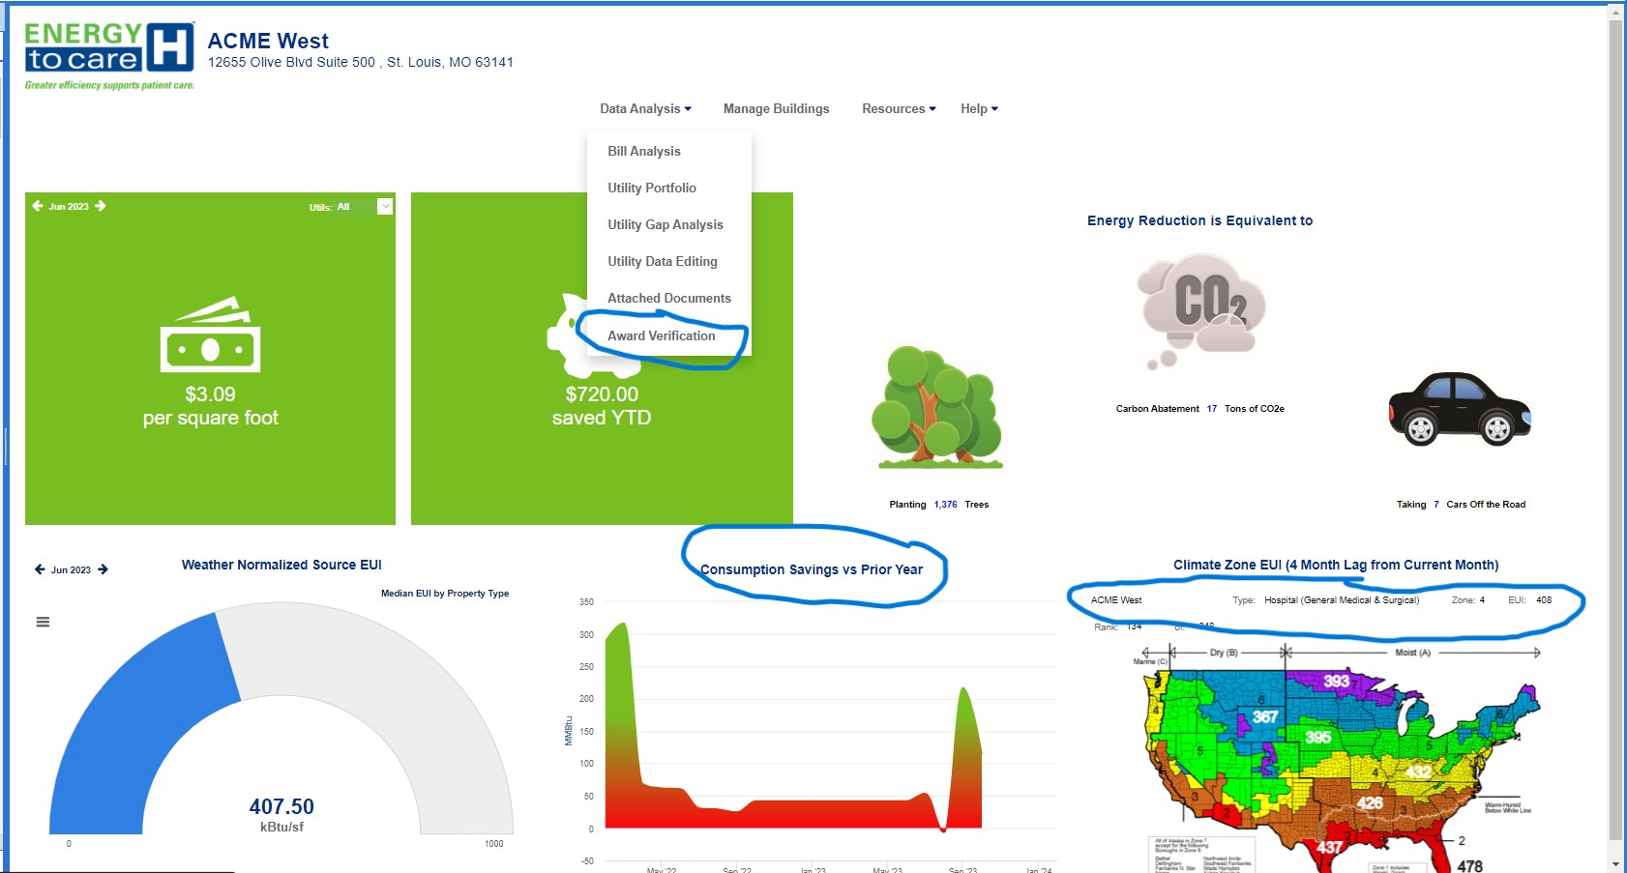
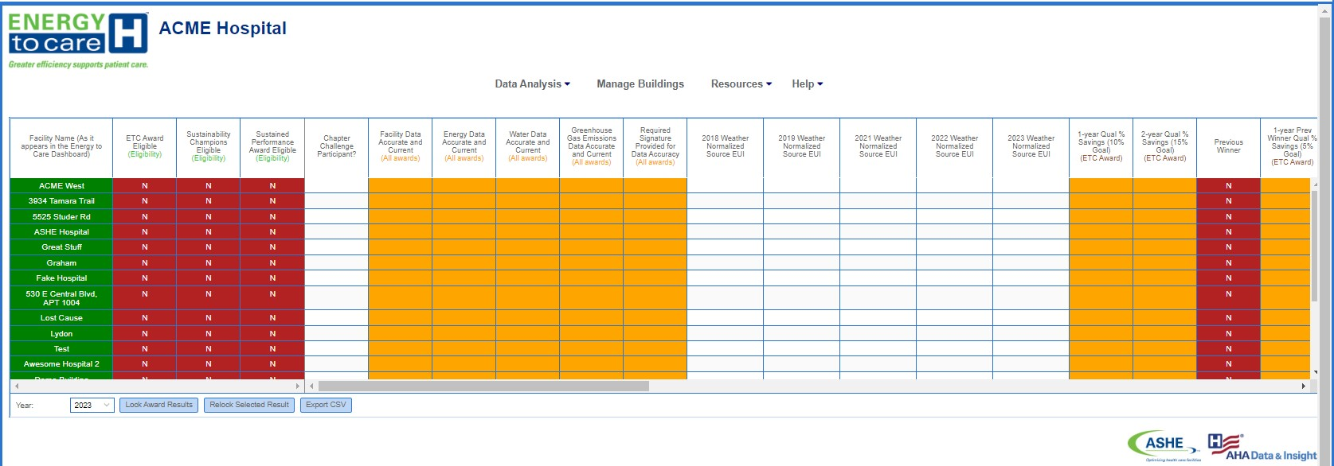
Energy to Care Dashboard Updates
Updates include-
EUI gauge to show Weather Normalized Source EUI
Map Widget to show regional EUI based on selected building type
New Consumption Savings widget showing year over year total consumption savings.
Awards Verification Tab
Allows view of all buildings operated
Track awards eligibility
Application and document submission

Slide 25
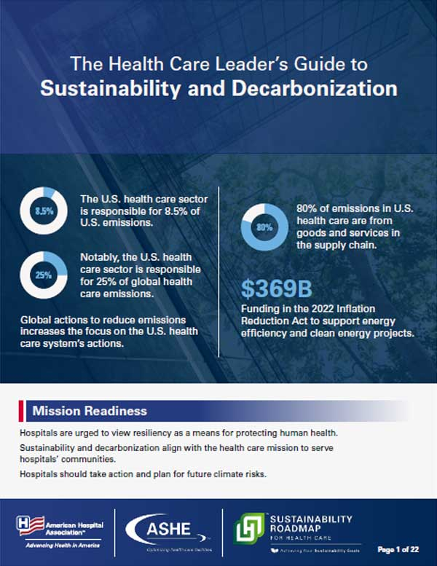
The Health Care Leader's Guide to Sustainability and Decarbonization
New free resource that looks at Sustainability and Decarbonization from the perspective of leadership.
Provides definitions, themes, and tangible action items specific to;
CEOs
Boards and Trustees
Sustainability Teams
COOs
CFOs
Demonstrates how these groups can lead the way in environmental stewardship within their organizations.
https://www.aha.org/sustainability/sustainability-accelerator-toolkit

Slide 26
Important Chapter Due Dates

Slide 27
Important Chapter Due Dates
Chapter Awards Application
Chapter Awards Program Vouchers
Emerging Regional Leader Award
2025 Chapter Challenge
Energy to Care Awards
Due
April 1!
Visit ashe.org/chapters to access the applications and program guides.

Slide 28
Chapter Voucher Program
4 vouchers given as part of the Chapter Awards program
Health Care Facilities Innovation Conference Registration Fee
ASHE Member Dues
ASHE Publications
CHFM and CHC Exam Fee
Chapters select members to receive vouchers based on criteria (listed on voucher request forms)
The current vouchers are for the 2023 Chapter Awards.
2022 - Work Completed
2023 - Chapter Awards Given
2024 - Vouchers Provided & Utilized

Slide 29
ICC Update

Slide 30
ICC 2027 Code Cycle
Group A Code Change Proposals posted 26 February
ICC Committee on Health Care submitted 8 proposals
FS31 – Separating of smoke compartments
FS65 – Group I-1, Condition 2 door closers
G2 – Definition of Clinical Need
F80 – Installing of electrical systems and equipment
F101 – Group R-4, Condition 2 sprinkler systems
F160 – Group I-2 Electrical systems
F163 – Health Care Microgrids
E61 – Control Vestibules

Slide 31
ICC 2027 Code Cycle
ICC Committee on Health Care co-sponsored 4 Proposals
F232 – ABHR storage, use and handling
F258 – ABHR Mounting locations
F259 – ABHR aggregate quantity
F260 – ABHR storage/maximum allowable quantities

Slide 32
Code Action Committee Hearings
All Group A proposals available at:
https://www.iccsafe.org/products-and-services/i-codes/code-development-process/2024-2026-group-a/
Hearings April 7th – April 16th
Hearings in person only
DoubleTree by Hilton at the Entrance to Universal Orlando, Orlando Fl
Hearings will be streamed live over ICC Webpage
ICC CHC representatives will be present

Slide 33
Regional Nominating Committees

Slide 34
2024 ASHE Election Timeline
Open positions (terms to start 1/1/2025):
President-elect
Associate Member Representative (one of the two seats)
Regional Representatives for Regions 1, 2, 4, 5, and 9
Call for potential candidates now open!
Eligible ASHE members who would like to be considered as a candidate for the ASHE Advisory Board need to complete the position’s potential candidate questionnaire by
11:59 pm CT on March 15, 2024. Visit ashe.org/ashe-elections
The National Nominating Committee will review the potential candidates for President-elect and Associate Member Representative and nominate at least 2 and no more than 3 candidates to run in the 2024 Election.
The Regional Nominating Committees will review their region’s potential candidates and nominate no more than three candidates to run in the 2024 Elections.

Slide 35
Regional Nominating Committees (RNC)
Comprised of all Chapter Presidents in the region
Will meet virtually to review the potential Regional Representative candidates and nominate up to 3 candidates to run in the election.
Doodle polls will be sent out following the call.
Chapter Presidents who have submitted their name for consideration need to contact Jenny Hull, Elections Secretary, to recuse themselves from their RNC.
*Note: All items discussed in these calls and information about the candidates is confidential. All RNC members will need to maintain confidentiality regarding any discussions or information provided.

Slide 36
PDC Sustainability Sessions

Slide 37
PDC Sustainability Sessions
Monday, March 18th
10:00am – 11:00am - The Rise of the Climate Economy and how Energy Incentives can Benefit the Healthcare Industry
1:00pm – 2:00pm - Sustainability in Academic Medical Centers Meeting
2:15pm – 3:45pm - General Session: Prescribing Sustainability: Exploring Paths to Hospital Decarbonization
4:00pm – 5:00pm - Seven Steps to Decarbonization
Tuesday, March 19th
7:00am – 8:00am -The Future of Energy-Efficiency in Healthcare: Net-Zero and Beyond
10:00am – 11:00am – Prescribing Sustainability General Session Roundtable Discussion
4:00pm – 5:00pm - How California Is Making Microgrids Work
Wednesday, March 20th
8:15am – 9:15am - Finding Common Ground Between Sustainability and Life Safety
9:30am – 10:30am - ASHE/ASHRAE Decarbonization Design Guide

Slide 38
2024 Meeting Dates and Upcoming Events

Slide 39
2024 Chapter Leader and Liaison Calls
Q2: Wednesday, June 5, 2024
Q3: Wednesday, September 4, 2024
Q4: Wednesday, December 4, 2024
All calls begin at 12:05 noon CT.
Call reminders – Chapter Calendar, myASHE Community, and Liaison SharePoint site
2024
CL/L Call Dates
ashe.org/chapters/calendar

Slide 40
Upcoming Events
At the PDC Summit, ASHE will be video recording interviews of our PDC audience for education and marketing purposes.
If you are attending the PDC Summit and want to learn more and sign up, you can do so at: https://www.signupgenius.com/go/10C0E4CA9A72EA2FDC70-48343964-pdc2024#/

Slide 41
Upcoming Events

Slide 42
Upcoming Events
July 21-24, 2024 Anaheim, CA

Slide 43
Questions or Discussion?

Slide 44
Thank you!

