Slide 1
Employee Self Screening

Slide 2
Table of Contents
Employee Screening Procedure
Infrared Thermometers
Contact Information
Click to Continue

Slide 3
Employee Self Screening Process
Self/Regular monitoring is required of all employees. Employees should self monitor on a daily basis by referencing the appropriate screening questions and taking temperature.
1. New Fever?
2. NEW Cough?
3. NEW Shortness of Breath?
4. Self Temperature check upon arrival at work
If the answer to any of these questions is YES, the employee must immediately leave facility and must call Employee Health
If the employee has a temperature reading of ≥ 100.4° F, the employee must exit facility and call Employee Health
Once an employee has completed the self screening process, he/she may report to work station and start working.
Click to Continue

Slide 4
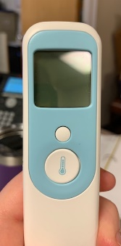
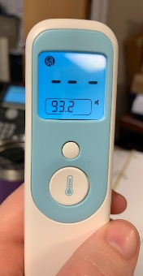
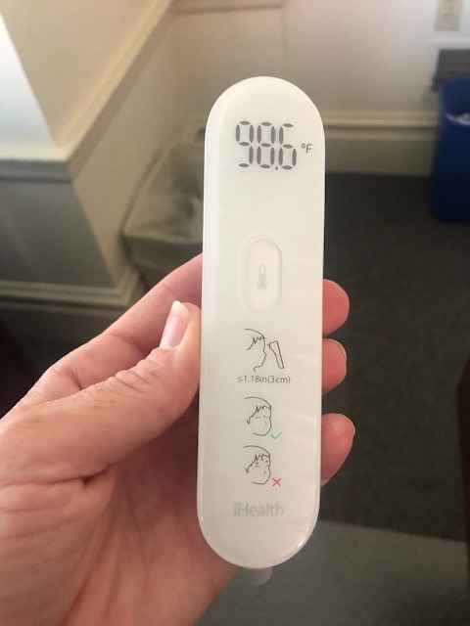
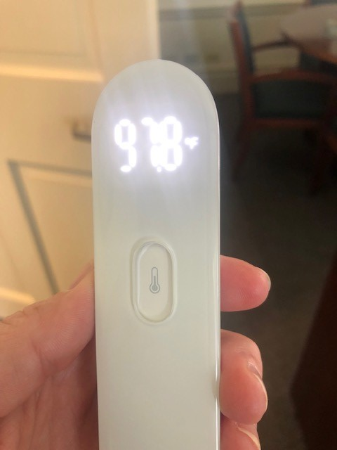
Temperature Process
1. Activate Thermometer by pressing button.

Slide 5
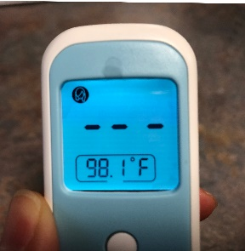
Temperature Process
2. Verify thermometer mode is on “adult forehead”
3. To change mode, press the small button until proper mode is selected.
Click to Continue

Slide 6
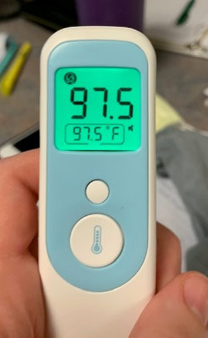
Temperature Process
4. Hold thermometer 3 cm away from skin on employees’ forehead
5. Press button to take temperature
6. Assess for fever - ≥ 100.4° F
**Employee must leave facility and call Employee Health once home if temperature reads ≥ 100.4° F
Click to Continue

