Slide 1
OT Cybersecurity and Impact on Patient Care in Health Care Facilities
October 15th, 2019
Anthony Ciccozzi, PE, GICSP, PMP

Slide 2
Learning Objectives
Learn what facility managers can do to protect healthcare facilities/patients from cybersecurity threats
Understand differences between Information Technology (IT) and Operations Technology (OT) networks
Learn how OT vulnerabilities could negatively impact patient care
Review common security vulnerabilities Healthcare facilities (through the presentation of a case study)
Learn how facility managers can evaluate the cybersecurity state of their Healthcare system through a simple framework of questions
Other terms used (depending on the specific context and vendor):
ICS = Industrial Control System
BAS = Building Automation System
BMS = Building Management System
EPMS = Electrical Power Monitoring System
SCADA = Supervisory Control and Data Acquisition
The term OT will be used when referring to the Healthcare Facility networks (Electrical Infrastructure, Building Automation, etc.)

Slide 3
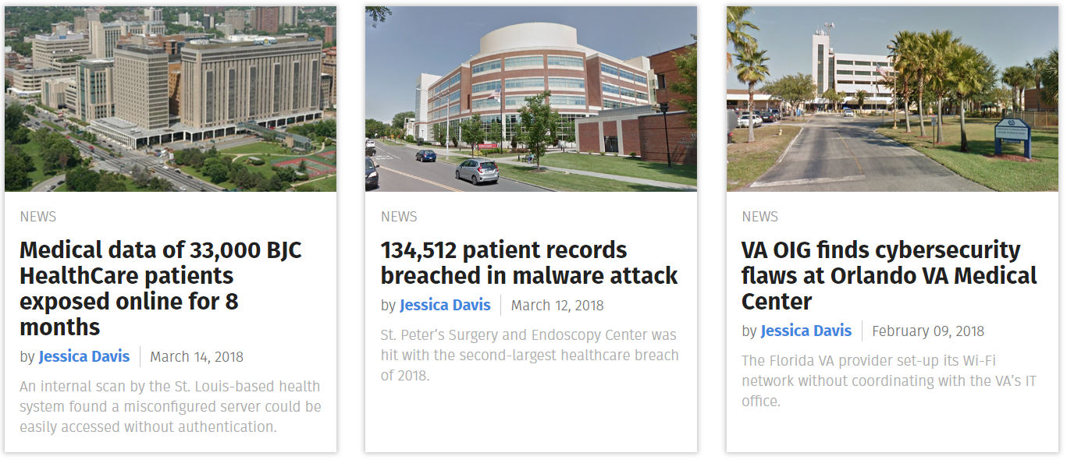
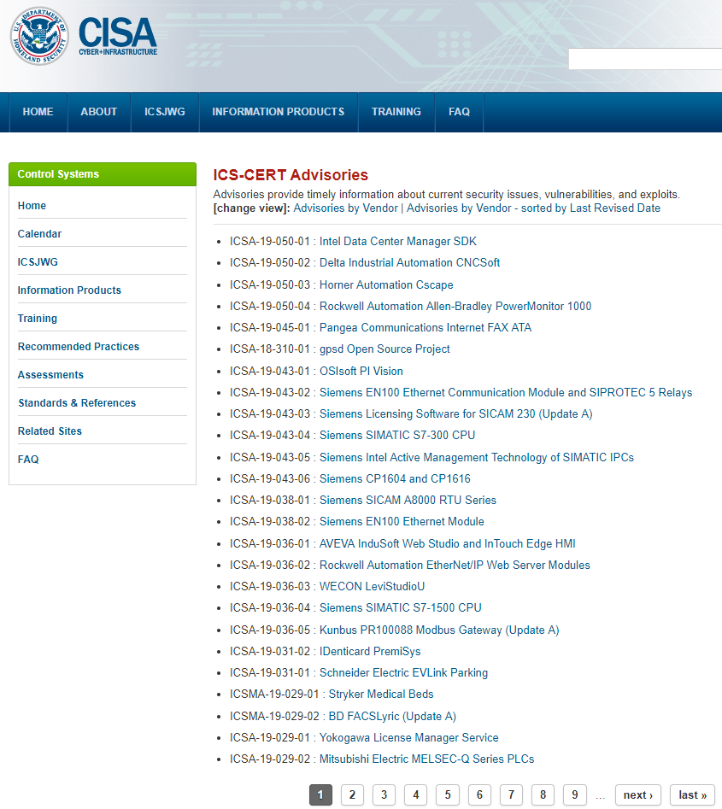
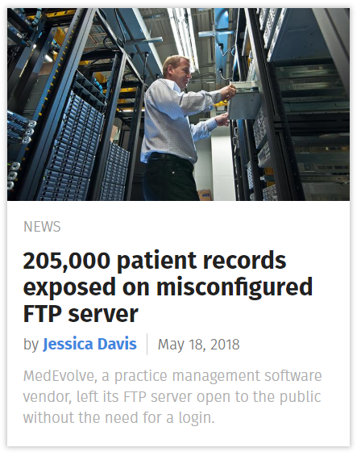
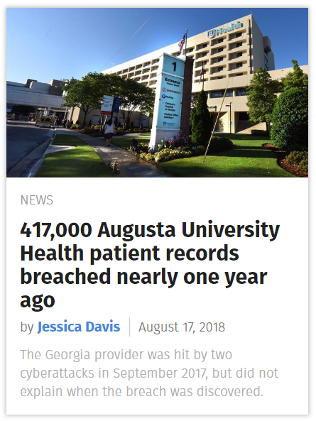
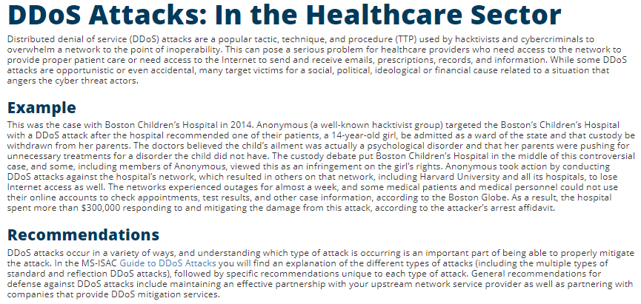
Healthcare Sector as a Target
Multiple motives… impact patient healthcare delivery, patient health/financial data, ransomware, terror/societal disruption, infant abduction, drug theft

Slide 4

Cybersecurity Incident Review and Takeaways
  December 2013: up to 110 million Target Corporation customer financial and personal exfiltrated to external server.
  Spear Phishing to steal remotes access credentials from an HVAC and refrigeration company
  Gained remote access to the network, exploited known vulnerabilities, pivoted around network (exploiting weak segmentation/boundary defenses), installed malware on Point of Sale (POS), exfiltrated data to external server
  Target had the Technology (an expensive IDS and malware prevention tools) – but the People and Process were lacking:
  “Target’s FireEye malware intrusion detection system triggered urgent alerts with each installation of the data exfiltration malware… Target’s security team neither reacted to the alarms nor allowed the FireEye software to automatically delete the malware in question. Target’s Symantec antivirus software also detected malicious behavior around November 28, implicating the same server flagged by FireEye’s software.”
Analysis of the attacks found weaknesses in overall vulnerability management, cybersecurity maintenance and supply chain cybersecurity
  1. Brian Krebs, Sources: Target Investigating Data Breach, KrebsOnSecurity (Dec. 18, 2013) (online at http://krebsonsecurity.com/2013/12/sources-target-investigating-data-breach/)
2. https://www.commerce.senate.gov/public/_cache/files/24d3c229-4f2f-405d-b8db-a3a67f183883/23E30AA955B5C00FE57CFD709621592C.2014-0325-target-kill-chain-analysis.pdf

Slide 5
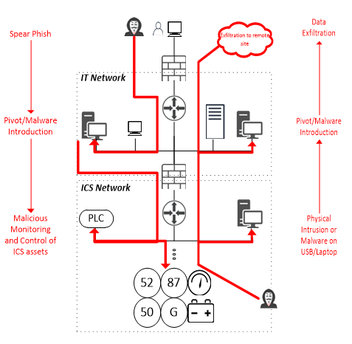
Cybersecurity Risks in a Nutshell for Facility OT
Attacks can originate:
  From the Outside into OT
  From OT into larger IT infrastructure
Attack Surface: Sum of the points where an attacker can interact with the system (input, output, manipulate control, elevate privilege, etc.)
Attacker Objectives
Primary attack (e.g. disconnect power)
Supporting attack (e.g. UPS disconnect)
Establish remote access/exfiltration point
Loss of View/Control
Manipulation of View/Control

Slide 6









Healthcare Facility OT Lacks Direct Cybersecurity Standards
Health Insurance Portability and Accountability Act (HIPAA)
Privacy Rule and Security Rule govern Protected Health Information (PHI) electronic Protected Health Information (ePHI)
NFPA 99: Health Care Facilities Code provides risk-based approach to facility Safety and Availability.
U.S. FDA issues pre-market and post-market guidance and approval for medical devices
OT focused industry standards and best practices exist that give specific consideration to availability and real-time needs
  Additional action is needed to protect patients and staff from cybersecurity threats - there is not one size fits all certification or standard!

Slide 7
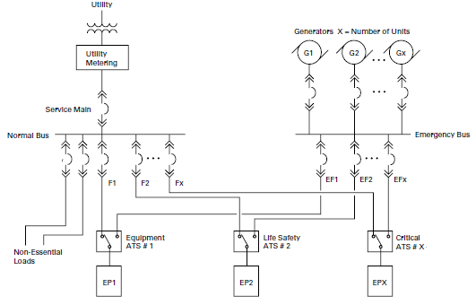
Healthcare Facility OT: Electrical Infrastructure Overview
Power System
Power System Functions
Protection
Breakers
Relays
Meters
UPS
PLC/Real-Time Controller
Transfer Switching
Generator Paralleling
Generator Control
Ground Fault Protection
Surge Protection
Battery Monitoring
Time-sensitive and critical applications… like Transfer Switching, require fast response and high availability often leading to the use of specialized controllers to provide Hot Standby redundancy.
Automation System
Network Switches
Routers
Firewalls
Comm Gateways
HMI
Server
Controller A
Controller B
Controller A fails over to Controller B that is fully synchronized and can provide no disruption (bump-less transfer).
Electrical infrastructure is part of overall Attack Surface. Consider other adjacent systems: medical gas, HVAC, lighting, fire and, public address, etc.

Slide 8
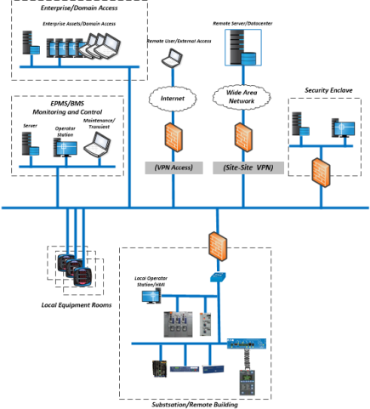
Healthcare Facility OT: Cybersecurity Context
Electrical infrastructure, physical asset distribution, and monitoring and control requirements…
Determine the overall architecture and attack surface….

Slide 9
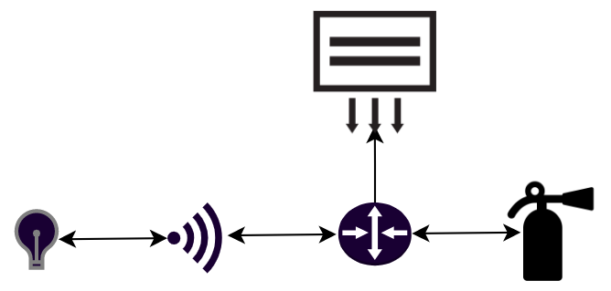
Healthcare Facility OT Characteristics
Distributed network of vendor specific and Commercial Off the Shelf (COTS) components
Distributed authority for assets and network (Facilities/OT vs. IT)
Industrial equipment and protocols (e.g. Modbus TCP, BACNet, etc.)
Static, real-time, deterministic traffic/data flows
Patching/updating devices not possible/practical
Remote accessibility (for maintenance and troubleshooting)
Differing security objectives from standard IT:
  (OT/EPMS/BAS)
  1. Availability
  2. Integrity
  3. Confidentiality
  (IT)
  1. Confidentiality
  2. Integrity
  3. Availability
Several adjacent systems tied together by common infrastructure
OT cybersecurity risks are not typically fully considered by IT!
Lighting control systems
HVAC
Fire Detection/Suppression
Public Address

Slide 10
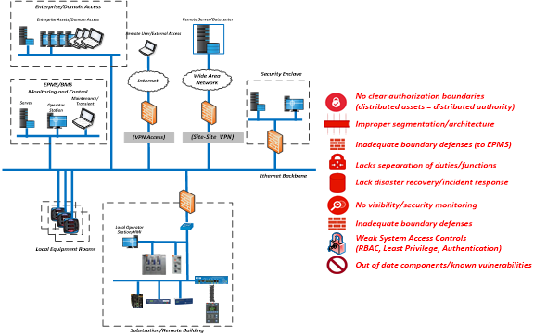
Case Study: U.S. Healthcare Facility
Relatively minor investment can make big improvements:
  Updating asset inventories
  Patching/updating devices
  Updating access controls
  Adding a few (OT) firewalls
  Extending IT monitoring to OT assets
  Integrating security maintenance
Several devices were used that supported capability to integrate into overall IT security monitoring
  Example: OT specific network switch was installed without any of the necessary features configured
Takeaway: Otherwise “secure” organizations have serious gaps in Facility OT cybersecurity

Slide 11

Actions for Facility OT Leaders
Effective Cybersecurity for Facility OT a full lifecycle risk management activity requiring comprehensive consideration of People, Process, and Technology
Inventory… all connected hardware, software, dataflows and correlate Reality, Monitoring, and Drawings
Collaborate… with vendors and internal stakeholders to review roles & responsibilities and identify gaps in governance (e.g. disaster recovery and incident response)
People
Process
Technology
Integrate… cybersecurity into overall lifecycle maintenance (look for overlap in activities, skillsets, and competencies
Train… staff on OT specific cybersecurity considerations including best practices and policies around USB and maintenance laptops
Perform an OT focused Assessment!
Done properly can be executed on running systems using Passive Scanning and OT specific tools and techniques
Assess… facility OT networks and assets to evaluate the attack surface and discover known vulnerabilities and weaknesses

Slide 12
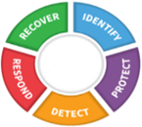


Assessing Facility OT: Focus Areas
Asset Inventory - Know what you have, know how it is connected, know how (if) it is monitored
Vulnerability Management – Discover and address (mitigate/remediate) vulnerabilities (patch, configuration, etc.)
Technical Framework
Architecture and Boundary Defenses –Verify segmentation, remote access, traffic restriction, intrusion detection, functional isolation
Log Review and Analysis - Verify all devices are monitored and review all alerts and logs for malicious/unauthorized activity
Base on NIST Cybersecurity Framework (CSF)
Customize for OT: e.g. use mappings to IEC-62443, Center for Internet Security (CIS) Critical Security Controls (CSC)
Add consideration to real-time and critical functions¹
Access Controls - Verify default usernames and passwords have been changed
Backup and Recovery - Verify all assets have recent backups (or at least documented configurations)
Secure Configuration – Verify configurations per vendor guidance, disable unnecessary ports and services
1. As an example a mapping to ID.BE-4 Dependencies and critical functions for delivery of critical services are established in the CSF could be added

Slide 13
Assessing Facility OT: Cybersecurity Maintenance
Yearly (Every 15 Months)
Industry standards and best practices specify bi-weekly, monthly, and yearly activities
Comprehensive vulnerability assessments effectively serve as a review of cybersecurity maintenance activities
Asset inventory and baseline generation
Network topology and drawing review
Vulnerability Assessment
Monthly (Every 35 days)
Pre-update configuration baseline
Backup system assets
Vulnerability review (vendor and public)
Deploy patches and firmware updates
Deploy “security” updates (e.g. AV definitions)
Review access control lists
Verify it…
Review user accounts and controls
Verify no unauthorized devices or software are on Facility OT networks
Verify no known vulnerabilities
Verify all devices are monitored for malicious/unauthorized activity
Verify no insecure/unauthorized remote access exists
Verify logs and alerts have been reviewed an indicate no malicious activity
Verify disaster recovery and incident response plans consider Facility OT
Post-update configuration baseline
Bi-weekly
Logging review and analysis
Time synchronization verification
Additional Activities
System health assessment
Redundancy testing
Configuration management update
Disaster recovery tabletop exercises
Incident response tabletop exercises

Slide 14
Evaluating Facility OT Cybersecurity Evaluation
Perform this basic evaluation for Facility OT… No and Partial response indicates gaps and potential risks
Are only authorized devices communicating on the network? | Yes | ☐ | No | ☐ | Partial | ☐
Is remote access to system assets secure (strong access controls, boundary defenses, etc.)? | Yes | ☐ | No | ☐ | Partial | ☐
Are unaddressed vulnerabilities present on any system assets? | Yes | ☐ | No | ☐ | Partial | ☐
Is network traffic monitored for unauthorized, anomalous, and malicious behavior? | Yes | ☐ | No | ☐ | Partial | ☐
Are strong system access controls in place and least privilege applied (e.g. no default passwords)? | Yes | ☐ | No | ☐ | Partial | ☐
Are asset owners, authorization boundaries, and responsibilities clearly defined? | Yes | ☐ | No | ☐ | Partial | ☐
Do accurate inventories of authorized hardware, software, and dataflows exist? | Yes | ☐ | No | ☐ | Partial | ☐
Do accurate network/topology drawings exist showing all connected devices? | Yes | ☐ | No | ☐ | Partial | ☐
Are secure configurations for all assets defined and deployed (no default credentials, only necessary ports and services running/open, disable unused physical ports, etc.)? | Yes | ☐ | No | ☐ | Partial | ☐
Does an asset (device) qualification and decommissioning program exist? | Yes | ☐ | No | ☐ | Partial | ☐
Are trust boundaries identified and segmentation/boundary defenses deployed? | Yes | ☐ | No | ☐ | Partial | ☐
Are malicious code detection/prevention mechanisms deployed and up to date? | Yes | ☐ | No | ☐ | Partial | ☐
Are assets included in a security monitoring and protection program? | Yes | ☐ | No | ☐ | Partial | ☐
Are all assets synchronized to the same (accurate) time and time zone? | Yes | ☐ | No | ☐ | Partial | ☐
Does a vulnerability management program exist? | Yes | ☐ | No | ☐ | Partial | ☐
Are vulnerability assessments performed on the system (at least yearly)? | Yes | ☐ | No | ☐ | Partial | ☐
Does an incident response program exist? | Yes | ☐ | No | ☐ | Partial | ☐
Does a backup and disaster recovery program exist? | Yes | ☐ | No | ☐ | Partial | ☐
Does a cybersecurity awareness program exist (for employees and vendors)? | Yes | ☐ | No | ☐ | Partial | ☐
Does a transient asset/removable media cybersecurity hygiene program exist? | Yes | ☐ | No | ☐ | Partial | ☐

Slide 15
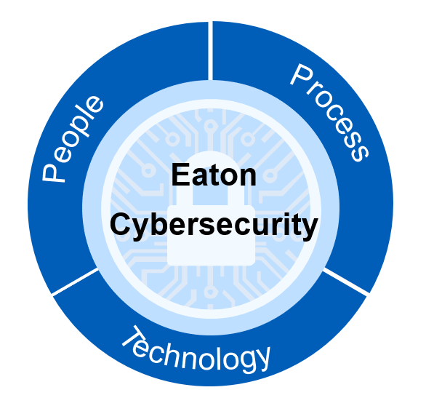


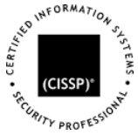
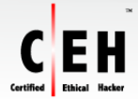


Eaton Cybersecurity Services
Eaton’s Cybersecurity Services can help you maximize patient safety and hospital uptime by focusing on all 3 tenants:
  People: Ensure your staff is trained on best practices and awareness
  Process: Put a system in place - know what to measure & how to respond
  Technology: Analyze attack surface, risks, and help address vulnerabilities and gaps
Eaton’s Cybersecurity Services team is uniquely positioned as your most qualified partner
  Cross-functional team of Power management and OT Cybersecurity Experts
  Services Team is well versed on the latest cybersecurity industry standards and best practices
  Eaton runs the first certified lab under UL2900

Slide 16




Eaton Cybersecurity Service Offerings
Our services are designed to be minimally disruptive to your staff & performed on operational equipment
 | What is it? | What you get out of it.
Eaton Audit | An assessment of the maturity and implementation of your overall Cybersecurity program with a focus on your people, processes & technology. | You will receive an overall Eaton fitness score and report on your cybersecurity program derived from industry standards and best practices. Your will gain visibility to your strengths and weaknesses with improvement recommendations.
Eaton Assessment | Builds upon the Audit by performing an in-depth connected device architecture analysis to determine your threat model. Passive data collection on your operational system will enable a vulnerability analysis and device configuration security review. | An Eaton cybersecurity leader will walk you through your identified attack surface profile and associated vulnerabilities and weaknesses. A prioritized lists of all findings with recommendations on how to address each will be delivered, along with a corrective action proposal.
Eaton Life-Cycle Management Never one and done. | Provides ongoing services to ensure your cybersecurity measures remain sufficient, comprehensive and integrated into your lifecycle management. | Reoccurring assessment of your people, processes and technology to ensure you are keeping pace with the evolving threat space and existing practices do not erode over time.
Eaton offers training, consulting and remediation services to address identified vulnerabilities to help you maximize patient safety and well being.

Slide 17

Eaton cybersecurity services initiative
“We’ll focus on your power system... you focus on your business”
Installation and commissioning
Cybersecurity assessment
Cybersecurity hardening and security updates
Training and situation awareness
Governance and compliance
Secure architecture and design
Questions?

Slide 18
OT Cybersecurity and Impact on Patient Care in Health Care Facilities
October 15th, 2019
Anthony Ciccozzi, PE, GICSP, PMP
AnthonyCiccozzi@eaton.com

